Slide 1



Welcome to the Cyber Universe:
Engaging High School Students in STEM Disciplines
NASA Space Grant Symposium, Tucson, Arizona
Surbhi Patel, The University of Arizona
April 16, 2016

Slide 2
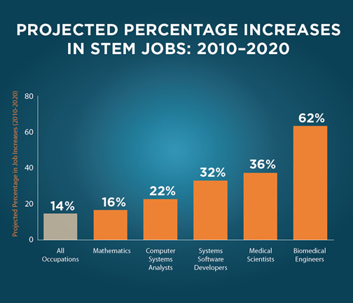
Introduction: Importance of STEM
STEM-related fields are increasing in demand
44 percent of 2013 U.S. high school graduates are ready for college-level math
36 percent of 2013 U.S. high school students are ready for college-level science
9 percent of Hispanic and 10 percent of black U.S. students took advanced Algebra or calculus in 2008, compared to 22 percent of white students and 43 percent of Asian students
(Source: STEM EDUCATION STATISTICS)
(Source: U.S. Department of Education)

Slide 3

What Is CyVerse:
  Provides life scientists a computational infrastructure to manage, and analyze their data
Vision:
  Transforming science through data-driven discovery
Mission statement:
  To design, deploy, and expand a national cyberinfrastructure for life sciences research and train scientists in its use

Slide 4


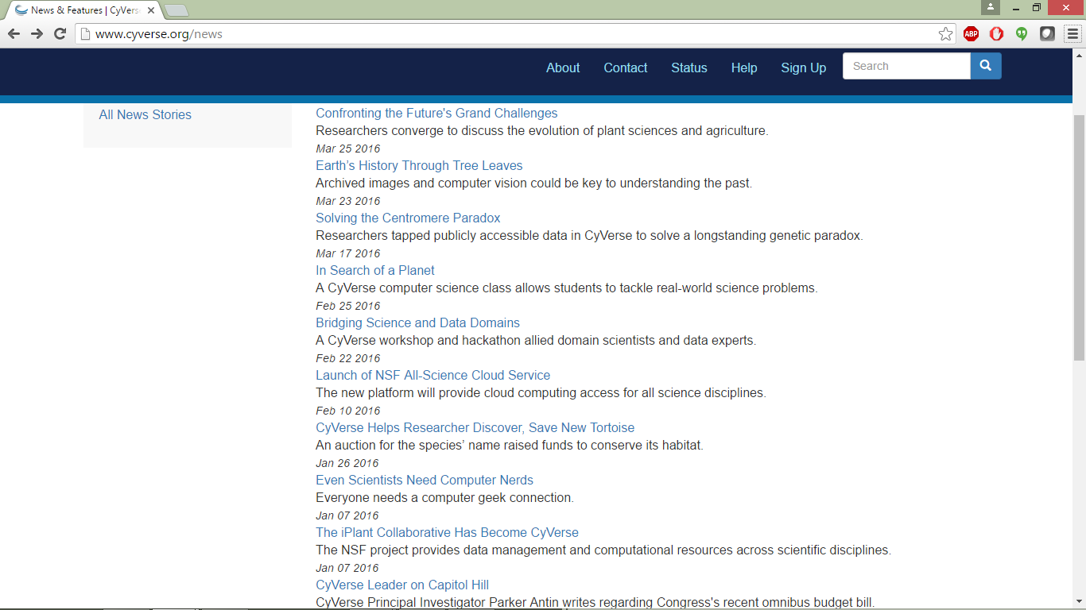

Slide 5
Aim & Methods:
Aim: Demonstrate relevance and importance of STEM-related fields through Interdisciplinary Approach
Created PowerPoints regarding each field
Discussed Relevance of Biology
Discussed Computer Science
Taught Binary Code
Binary Activity
DNA Subway
Students Created Phylogenetic Trees

Slide 6
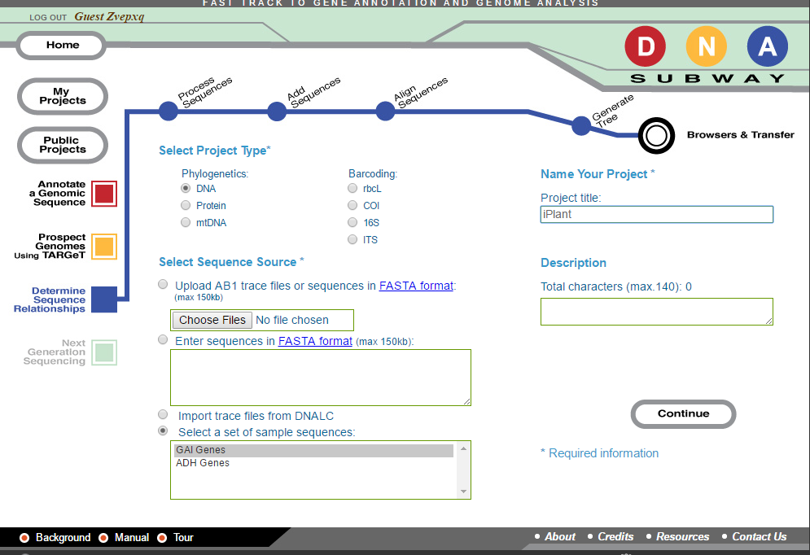
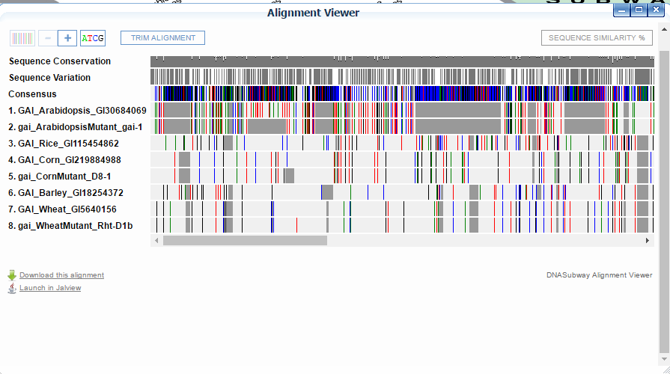
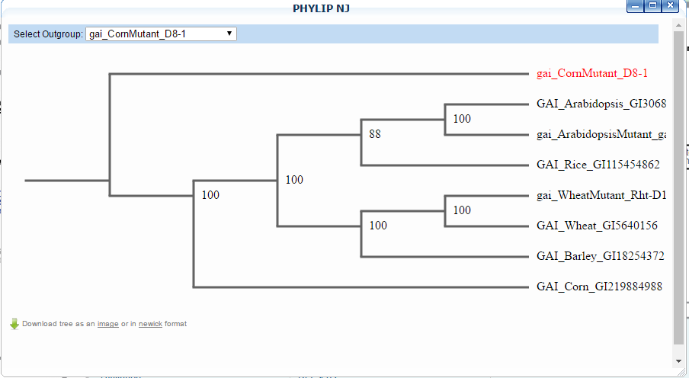
DNA Subway: Blue Line

Slide 7
Survey Results:
94% of students learned something new
66% of students chose Binary Code and DNA Activity as their favorite part of the presentation
Significant increase in interest in Computer Science after outreach activities (38% → 67%)
95% of student thought that the PowerPoint was presented “very well”

Slide 8
Results

Slide 9
Results

Slide 10
Conclusion & Future Direction
Conclusion
  STEM Outreach is successful at high school level
Future Direction:
  Make my material available on CyVerse
  Engage larger audience in Tucson
    Contact more high schools
  Develop a long-term program that includes mentorship and tracking of high school students

Slide 11
References
"Science, Technology, Engineering and Math: Education for Global Leadership." Science, Technology, Engineering and Math: Education for Global Leadership. U.S. Department of Education. Web. <http://www.ed.gov/stem>.
"STEM EDUCATION STATISTICS." NATIONAL MATH SCIENCE INITIATIVE. NATIONAL MATH SCIENCE INITIATIVE, 13 Jan. 2014. Web. <https://www.nms.org/AboutNMSI/TheSTEMCrisis/STEMEducationStatistics.aspx>.

Slide 12
Acknowledgements
Mentor: Shelley Littin, CyVerse
NASA Space Grant Program Directors
Carrie Bejarano, Amphitheater High School
Ann Marie Condes, Palo Verde High School
Mark Calhoun, Palo Verde High School
Margaret Wilch, Tucson High Magnet School

Slide 13
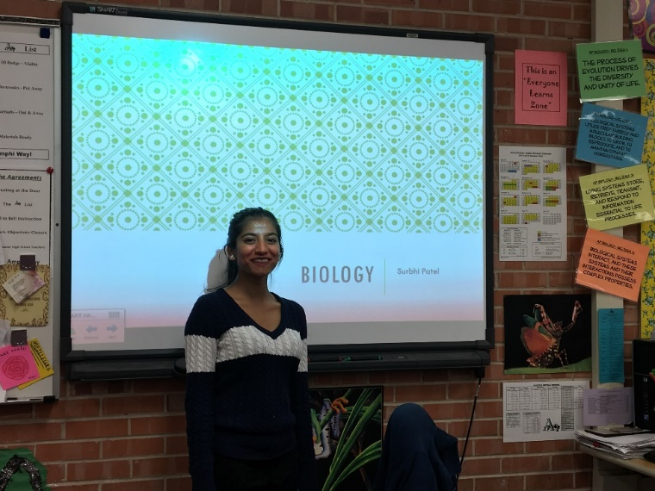
Thank You!
Surbhi Patel
Neuroscience and Cognitive Science
The University of Arizona
surbhibpatel@email.arizona.edu

Slide 14
Results

Slide 15
Results

Slide 16
Results

Slide 17
Results

Slide 18
Results

Slide 19
Results

Slide 20
Results

